Slide 1
Lecture 9
Inductive Strength

Slide 2
This week…
What is inductive strength?
To verify an inductive argument as strong or weak.

Slide 3
Arguments
Induction
Deduction
Common Patterns
Common Patterns
Deductive Validity
Inductive Strength

Slide 4
Inductive Strength
Inductive strength depends on how far extent the conclusion can derive from the premises.
It depends on whether the conclusion would probable be true if the premises were true.
Inductive Strength:
Strong: the conclusion follows probably from the premises.
Weak: the conclusion follow improbably from the premises.

Slide 5
Inductive Strength
If the argument’s premises were all true, would the conclusion be probably true?
No strong inductive argument can have true premises and a probably false conclusion.
P1: All previous Prime Minister have been women.
C: Therefore, the next Prime Minister will probably be a woman.
P1: All previous Prime Minister have been women.
C: Therefore, the next Prime Minister will probably be a man.
VS.
Strong
Weak

Slide 6
Inductive Strength
Strong Inductive Argument:
P1: Most SUC members own a smart phone.
P2: Andy is SUC members.
C: So, Andy probably owns a smart phone.
Weak Inductive Argument:
P1: Most SUC members own a smart phone.
P2: Andy is SUC members.
C: So, Andy probably does not own a smart phone.
Based on the true premises, the conclusion can be probably true!
Based on the true premises, the conclusion can be probably false!

Slide 7
Inductive Strength
The premise is true and the argument is strong!
Cogent argument:
Strong + having all true premises
P1: Most of SUC students are Johorians.
C: Therefore, probably most of the freshmen for the next semester are Johorians.
Uncogent argument:
Inductively weak or having at least one false premise
P1: All previous Prime Minister were football players.
C: Therefore, the next Prime Minister will be a football player.
The premise is false even the argument is strong!

Slide 8
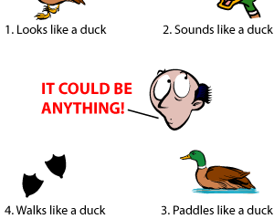
Inductive Generalization
Attributing some characteristic to all, most, or some members of a given set
Sample population → population as a whole
Form of Argument:
P: A1 has the quality of x, A2 has the quality of x…
C: Therefore, all A has the quality of x.

Slide 9
Inductive Generalization
Good inductive generalization:
The conclusion should not claim more than its premise can support.
Should not overstate its conclusions
P1: Most of the fishes Alan has caught in Skudai River have weighted less than 2kg.
C: So, all of the fishes Alan catches in Skudai River weigh less than 2kg.
P1: No dog Alan has come across has tried to attack him.
C: So, most dogs are not inclined to attack human beings.
Strong
Weak

Slide 10
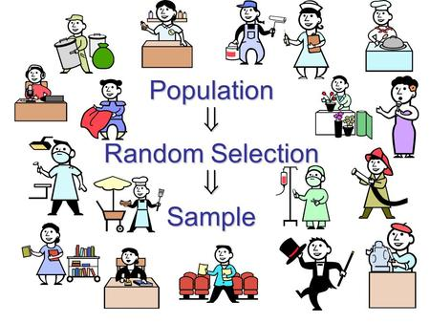
Inductive Generalization
Evaluating Inductive Generalizations:
Is the sample large enough?
Sample population must be sufficient to justify the conclusion
Is the sample representative?
A representative sample must have equal probability in selection and be inclusive, like the population as a whole in all relevant ways.

Slide 11
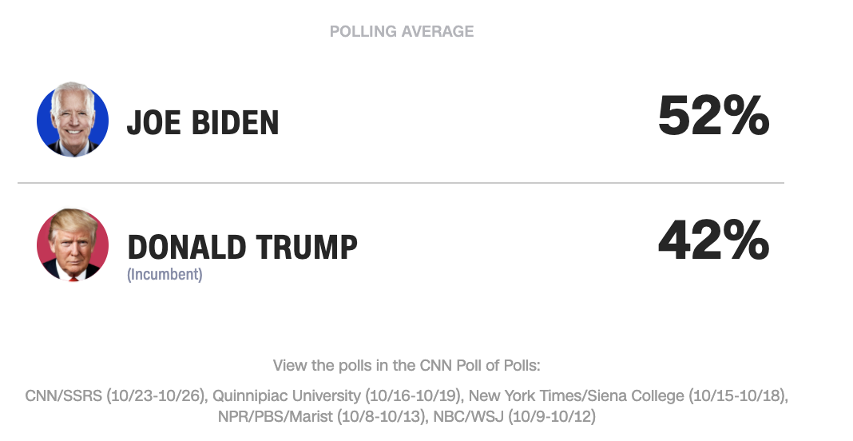
Statistical Argument
Resting on statistical evidence
Presented as probable rather than certain
P1: According to the latest opinion polls, 52% of people will vote for Biden.
C: Therefore, Biden will win the US presidential election.

Slide 12

Statistical Argument
Criterion:
Strong and reliable = over 50%
Strong but unreliable = around 50%
Weak = below 50%
Remarks on reference class:
More specific, More better
Additional new information can change its strength (positive or negative)

Slide 13
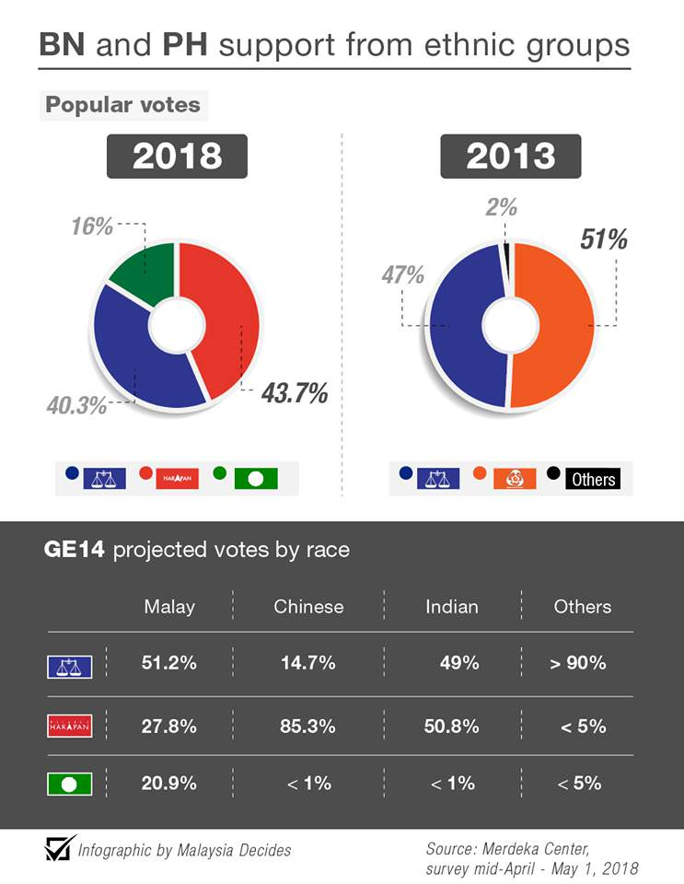
Statistical Argument
P1: In its final survey before tomorrow's general election, Merdeka Centre predicted that BN will win at least 100 parliament seats whereas Pakatan Harapan, 83.
C: Therefore, BN could win the election tomorrow.
P1: In its final survey before tomorrow's general election, Merdeka Centre predicted that BN will win at least 100 parliament seats whereas Pakatan Harapan, 83
C: Therefore, PH could win the election tomorrow.
Strong
Weak

Slide 14

Argument from Analogy
Comparison of two things
To be alike in some relevant respect
Example:
P1: The MBJB is a government agency.
P2: The Department of Transportation is a government agency.
P3: The MBJB is closed for Labour Day.
C: So, the Department of Transportation must be closed for Labour Day.

Slide 15
Argument from Analogy
Increasing samples make the argument more stronger or weaker.
P1: Mike and Billy are both tall and play basketball. P2: Mike also plays volleyball. C: Therefore, Billy must also play volleyball. | VS | P1: Mike, Roy, Jay and Billy are both tall and play basketball. P2: Mike, Roy and Jay also play volleyball. C: Therefore, Billy must also play volleyball.
P1: Mike’s German car was lemon and so was Fred’s C: Therefore, Roy’s German car is probably a lemon, too. |  | P1: Mike’s German car was lemon and so was Fred’s, Jay’s and Billy’s C: Therefore, Roy’s German car is probably a lemon, too.

Slide 16

Causal Argument
A cause is that which brings about a change, that which produces an effect.
The cause precedes the effect.
P1: Research has found that smoking cigarettes may increase the chances of getting lung cancer.
P2: He smokes two packs a day.
C: So, he will probably get lung cancer.

Slide 17
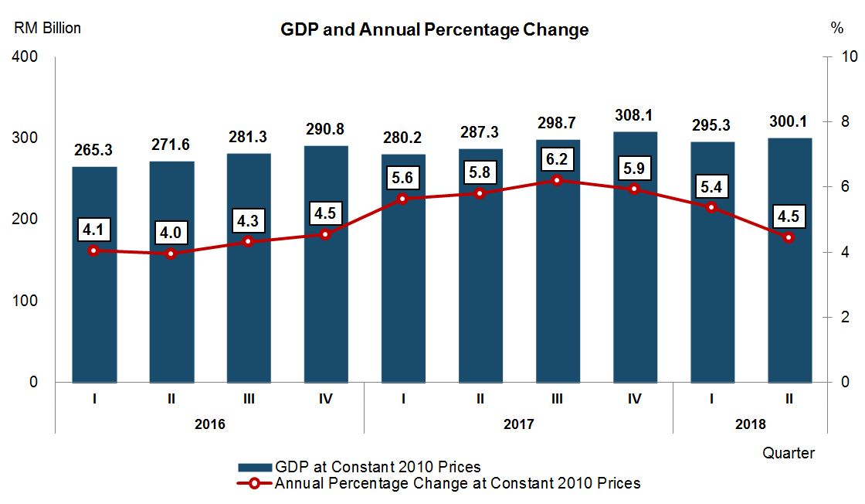

Causal Argument
The economy this year should grow. Aside from the gradual improvement in global growth, domestic demand would continue to be the main driver of the economy, supported by Government spending and the recovery in global commodity prices.
Every time we have a full moon, people behave strangely. So, the full moon must cause the strange behavior.
Weak Causal Connection
Strong Causal Connection

Slide 18
Argument from Authority
Citing some presumed authority or witness who has said that the claim is true
What makes it weaken?
Unreliable.
Wrong authority.
Falsification.
Too subjective.
Person S stated that p.
S is a reliable source.
Therefore, p is true.
My barber says that Einstein’s theory of relativity is totally false.
Therefore, our textbook should not teach his theory anymore.
Many reliable information show that there are weapons of massive destruction in Iraq.
Therefore, U.S. have no choice but declare on war to Iraq.

Slide 19
Predictive Argument
About what may or will happen in the future.
Nothing in the future is absolutely certain.
P1: The players are in a good form recently.
C: Therefore, it is likely that they will win the next game.
P1: The players are in a good form recently.
C: Therefore, it is likely that they will lose the next game.
Strong
Weak

Slide 20
Inductive Strength
Deductive Validity | Inductive Strength
It is impossible that the true premises could have false conclusion | No strong argument could have the true premises and false conclusion.
The premises conclusive support the conclusion logically necessary as true | The premises partial support the conclusion probably as true
All or nothing | A matter of degree
Defeasible by adding or removing premise | Indefeasible by adding or removing premise
Contradiction by denying conclusion | Conclusion always has exception

Slide 21
Concluding Remarks
An inductive argument could be strong or weak, cogent or uncogent.
An induction is strong if and only if the conclusion follows probably from the premises. For otherwise, it is weak.
There is no standard test for determining whether an inductive argument is strong or weak.
The argument can be strengthened or weakened by adding new premises.
The conclusion does come in degrees and have exception.
An induction is cogent if and only if it is strong and all its premises are true. It is uncogent if and only if it is weak or having at least one false premise.

